Slide 1
Parallel Programming Lecture Set 4 POSIX Threads Overview & OpenMP Johnnie Baker February 2, 2011

Slide 2
Topics
Data and Task Parallelism
Brief Overview of POSIX Threads
Data Parallelism in OpenMP
Expressing Parallel Loops
Parallel Regions (SPMD)
Scheduling Loops
Synchronization

Slide 3
Sources for Material
Primary Source: Mary Hall, CS4961, Lectures 4 and 5, University of Utah
Larry Snyder, Univ. of Washington, Ch. 4 slides, http://www.cs.washington.edu/education/courses/524/08wi/
Textbook, Chapters 4 & 6
Jim Demmel and Kathy Yelick, UCB
Allan Snavely, SDSC
Michael Quinn, Parallel Programming in C with MPI and OpenMP, Chapter 17

Slide 4
Definitions of Data and Task Parallelism
Data parallel computation:
Perform the same operation on different items of data at the same time; the parallelism grows with the size of the data.
Task parallel computation:
Perform distinct computations -- or tasks -- at the same time. If the number of tasks is fixed, the parallelism is not scalable.
Summary
Mostly we will study data parallelism in this class
Data parallelism facilitates very high speedups - and scaling to supercomputers.
Hybrid (mixing of the two) is increasingly common

Slide 5
Parallel Formulation vs. Parallel Algorithm
Parallel Formulation
Refers to a parallelization of a serial algorithm.
Parallel Algorithm
May represent an entirely different algorithm than the one used serially.
In this course, we primarily focus on “Parallel Formulations”.

Slide 6
Steps to Parallel Formulation
Computation Decomposition/Partitioning:
Identify pieces of work that can be done concurrently
Assign tasks to multiple processors (processes used equivalently)
Data Decomposition/Partitioning:
Decompose input, output and intermediate data across different processors
Manage Access to shared data and synchronization:
coherent view, safe access for input or intermediate data
UNDERLYING PRINCIPLES:
Maximize concurrency and reduce overheads due to parallelization!
Maximize potential speedup!

Slide 7
Concept of Threads
Text introduces Peril-L as a neutral language for describing parallel programming constructs
Abstracts away details of existing languages
Architecture independent
Data parallel
Based on C, for universality
We will instead learn OpenMP
Similar to Peril-L
However, OpenMP is a important programming language.

Slide 8
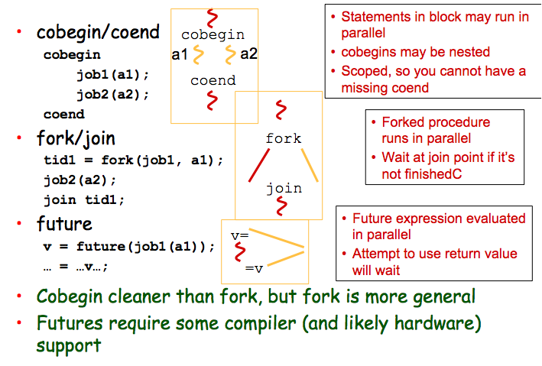
Common Notions of Task-Parallel Thread Creation (not in Peril-L)

Slide 9
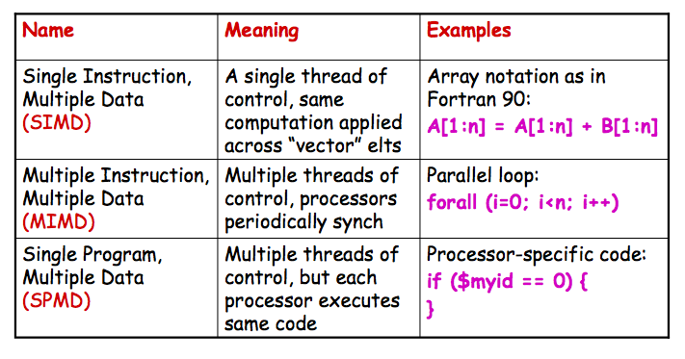
Review: Predominant Parallel Control Mechanisms

Slide 10
Programming with Threads
Several Thread Libraries
PTHREADS is the POSIX Standard
Solaris threads are very similar
Relatively low level
Portable but possibly slow
OpenMP is newer standard
Support for scientific programming on shared memory architectures
P4 (Parmacs) is another portable package
Higher level than Pthreads
http://www.netlib.org/p4/index.html
Notes:
POSIX = Portable Operating System Interface

Slide 11
Overview of POSIX Threads
POSIX: Portable Operating System Interface for UNIX
Interface to Operating System utilities
PThreads: The POSIX threading interface
System calls to create and synchronize threads
Should be relatively uniform across UNIX-like OS platforms
PThreads contain support for
Creating parallelism
Synchronizing
No explicit support for communication, because shared memory is implicit; a pointer to shared data is passed to a thread
See Chapter 6 of textbook for more details on Ptreads

Slide 12
Forking POSIX Threads
Signature:
int pthread_create(pthread_t *,
const pthread_attr_t *,
void * (*)(void *),
void *);
Example call:
errcode = pthread_create(&thread_id; &thread_attribute
&thread_fun; &fun_arg);
thread_id is the thread id or handle (used to halt, etc.)
thread_attribute various attributes
standard default values obtained by passing a NULL pointer
thread_fun the function to be run (takes and returns void*)
fun_arg an argument can be passed to thread_fun when it starts
errorcode will be set nonzero if the create operation fails
Notes:
Sample attribute: minimum stack size

Slide 13
Simple Threading Example
void* SayHello(void *foo) {
printf( "Hello, world!\n" );
return NULL;
}
int main() {
pthread_t threads[16];
int tn;
for(tn=0; tn<16; tn++) {
pthread_create(&threads[tn], NULL, SayHello, NULL);
}
for(tn=0; tn<16 ; tn++) {
pthread_join(threads[tn], NULL);
}
return 0;
}
Compile using gcc –lpthread
But overhead of thread creation is nontrivial
SayHello should have a significant amount of work

Slide 14
Shared Data and Threads
Variables declared outside of main are shared
Object allocated on the heap may be shared (if pointer is passed)
Variables on the stack are private: passing pointer to these around to other threads can cause problems
Often done by creating a large “thread data” struct
Passed into all threads as argument
Simple example:
char *message = "Hello World!\n";
pthread_create( &thread1,
NULL,
(void*)&print_fun,
(void*) message);

Slide 15
Posix Thread Example
#include <pthread.h>
void print_fun( void *message ) {
printf("%s \n", message);
}
main() {
pthread_t thread1, thread2;
char *message1 = "Hello";
char *message2 = "World";
pthread_create( &thread1,
NULL,
(void*)&print_fun,
(void*) message1);
pthread_create(&thread2,
NULL,
(void*)&print_fun,
(void*) message2);
return(0);
}
Compile using gcc –lpthread
Note: There is a race condition in the print statements

Slide 16
Explicit Synchronization: Creating and Initializing a Barrier
To (dynamically) initialize a barrier, use code similar to this (which sets the number of threads to 3):
pthread_barrier_t b;
pthread_barrier_init(&b,NULL,3);
The second argument specifies an object attribute; using NULL yields the default attributes.
To wait at a barrier, a process executes:
pthread_barrier_wait(&b);
This barrier could have been statically initialized by assigning an initial value created using the macro
PTHREAD_BARRIER_INITIALIZER(3).

Slide 17
Mutexes (aka Locks) in POSIX Threads
To create a mutex:
#include <pthread.h>
pthread_mutex_t amutex = PTHREAD_MUTEX_INITIALIZER;
pthread_mutex_init(&amutex, NULL);
To use it:
int pthread_mutex_lock(amutex);
int pthread_mutex_unlock(amutex);
To deallocate a mutex
int pthread_mutex_destroy(pthread_mutex_t *mutex);
Multiple mutexes may be held, but can lead to deadlock:
thread1 thread2
lock(a) lock(b)
lock(b) lock(a)

Slide 18
Summary of Programming with Threads
POSIX Threads are based on OS features
Can be used from multiple languages (need appropriate header)
Familiar language for most programmers
Ability to shared data is convenient
Pitfalls
Data race bugs are very nasty to find because they can be intermittent
Deadlocks are usually easier, but can also be intermittent
OpenMP is commonly used today as a simpler alternative, but it is more restrictive

Slide 19
OpenMP Motivation
Thread libraries are hard to use
P-Threads/Solaris threads have many library calls for initialization, synchronization, thread creation, condition variables, etc.
Programmer must code with multiple threads in mind
Synchronization between threads introduces a new dimension of program correctness
Wouldn’t it be nice to write serial programs and somehow parallelize them “automatically”?
OpenMP can parallelize many serial programs with relatively few annotations that specify parallelism and independence
It is not automatic: you can still make errors in your annotations

Slide 20
OpenMP: Prevailing Shared Memory Programming Approach
Model for parallel programming
Shared-memory parallelism
Portable across shared-memory architectures
Scalable
Incremental parallelization
Compiler based
Extensions to existing programming languages (Fortran, C and C++)
mainly by directives
a few library routines
See http://www.openmp.org

Slide 21
A Programmer’s View of OpenMP
OpenMP is a portable, threaded, shared-memory programming specification with “light” syntax
Exact behavior depends on OpenMP implementation!
Requires compiler support (C/C++ or Fortran)
OpenMP will:
Allow a programmer to separate a program into serial regions and parallel regions, rather than concurrently-executing threads.
Hide stack management
Provide synchronization constructs
OpenMP will not:
Parallelize automatically
Guarantee speedup
Provide freedom from data races

Slide 22
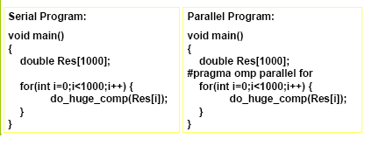
OpenMP Data Parallel Construct: Parallel Loop
All pragmas begin: #pragma
Compiler calculates loop bounds for each thread directly from serial source (computation decomposition)
Compiler also manages data partitioning of Res
Synchronization also automatic (barrier)

Slide 23
OpenMP Execution Model
Fork-join model of parallel execution
Begin execution as a single process (master thread)
Start of a parallel construct:
Master thread creates team of threads
Completion of a parallel construct:
Threads in the team synchronize -- implicit barrier
Only master thread continues execution
Implementation optimization:
Worker threads spin waiting on next fork
fork
join

Slide 24
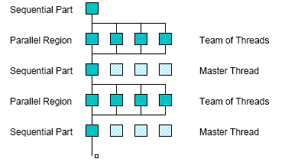
OpenMP Execution Model

Slide 25
Count 3s Example? (see textbook)
What do we need to worry about?

Slide 26
OpenMP directive format C (also Fortran and C++ bindings)
Pragmas, format
#pragma omp directive_name [ clause [ clause ] ... ] new-line
Conditional compilation
#ifdef _OPENMP
block,
e.g., printf(“%d avail.processors\n”,omp_get_num_procs());
#endif
Case sensitive
Include file for library routines
#ifdef _OPENMP
#include <omp.h>
#endif

Slide 27
Limitations and Semantics
Not all “element-wise” loops can be ||ized
#pragma omp parallel for
for (i=0; i < numPixels; i++) {}
Loop index: signed integer
Termination Test: <,<=,>,=> with loop invariant int
Incr/Decr by loop invariant int; change each iteration
Count up for <,<=; count down for >,>=
Basic block body: no control in/out except at top
Threads are created and iterations divvied up; requirements ensure iteration count is predictable

Slide 28
OpenMP Synchronization
Implicit barrier
At beginning and end of parallel constructs
At end of all other control constructs
Implicit synchronization can be removed with nowait clause
Explicit synchronization
critical
atomic (single statement)
barrier

Slide 29
OpenMp Reductions
OpenMP has reduce
sum = 0;
#pragma omp parallel for reduction(+:sum)
for (i=0; i < 100; i++) {
sum += array[i];
}
Reduce ops and init() values:
+ 0 bitwise & ~0 logical & 1
- 0 bitwise | 0 logical | 0
* 1 bitwise ^ 0

Slide 30
OpenMP parallel region construct
Block of code to be executed by multiple threads in parallel
Each thread executes the same code redundantly (SPMD)
Work within work-sharing constructs is distributed among the threads in a team
Example with C/C++ syntax
#pragma omp parallel [ clause [ clause ] ... ] new-line
structured-block
clause can include the following:
private (list)
shared (list)

Slide 31
Programming Model – Loop Scheduling
schedule clause determines how loop iterations are divided among the thread team
static([chunk]) divides iterations statically between threads
Each thread receives [chunk] iterations, rounding as necessary to account for all iterations
Default [chunk] is ceil( # iterations / # threads )
dynamic([chunk]) allocates [chunk] iterations per thread, allocating an additional [chunk] iterations when a thread finishes
Forms a logical work queue, consisting of all loop iterations
Default [chunk] is 1
guided([chunk]) allocates dynamically, but [chunk] is exponentially reduced with each allocation

Slide 32
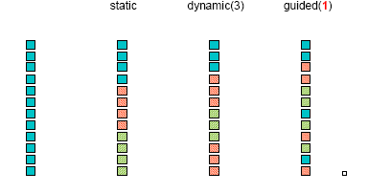
Loop scheduling
2
(2)

Slide 33
OpenMP critical directive
Enclosed code
– executed by all threads, but
– restricted to only one thread at a time
#pragma omp critical [ ( name ) ] new-line
structured-block
A thread waits at the beginning of a critical region until no other thread in the team is executing a critical region with the same name.
All unnamed critical directives map to the same unspecified name.

Slide 34
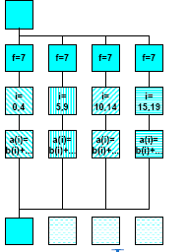
Variation: OpenMP parallel and for directives
Syntax:
#pragma omp for [ clause [ clause ] ... ] new-line
for-loop
clause can be one of the following:
shared (list)
private( list)
reduction( operator: list)
schedule( type [ , chunk ] )
nowait (C/C++: on #pragma omp for)
#pragma omp parallel private(f) {
f=7;
#pragma omp for
for (i=0; i<20; i++)
a[i] = b[i] + f * (i+1);
} /* omp end parallel */

Slide 35
Programming Model – Data Sharing
Parallel programs often employ two types of data
Shared data, visible to all threads, similarly named
Private data, visible to a single thread (often stack-allocated)
// shared, globals
int bigdata[1024];
void* foo(void* bar) {
// private, stack
int tid;
/* Calculation goes
here */
}
int bigdata[1024];
void* foo(void* bar) {
int tid;
#pragma omp parallel \
shared ( bigdata ) \
private ( tid )
{
/* Calc. here */
}
}
PThreads:
Global-scoped variables are shared
Stack-allocated variables are private
OpenMP:
shared variables are shared
private variables are private
Default is shared
Loop index is private

Slide 36
OpenMP environment variables
OMP_NUM_THREADS
sets the number of threads to use during execution
when dynamic adjustment of the number of threads is enabled, the value of this environment variable is the maximum number of threads to use
For example,
setenv OMP_NUM_THREADS 16 [csh, tcsh]
export OMP_NUM_THREADS=16 [sh, ksh, bash]
OMP_SCHEDULE
applies only to do/for and parallel do/for directives that have the schedule type RUNTIME
sets schedule type and chunk size for all such loops
For example,
setenv OMP_SCHEDULE GUIDED,4 [csh, tcsh]
export OMP_SCHEDULE= GUIDED,4 [sh, ksh, bash]

Slide 37
More loop scheduling attributes
RUNTIME The scheduling decision is deferred until runtime by the environment variable OMP_SCHEDULE. It is illegal to specify a chunk size for this clause.
AUTO The scheduling decision is delegated to the compiler and/or runtime system.
NO WAIT / nowait: If specified, then threads do not synchronize at the end of the parallel loop.
ORDERED: Specifies that the iterations of the loop must be executed as they would be in a serial program.
COLLAPSE: Specifies how many loops in a nested loop should be collapsed into one large iteration space and divided according to the schedule clause. The sequential execution of the iterations in all associated loops determines the order of the iterations in the collapsed iteration space.

Slide 38
Impact of Scheduling Decision
Load balance
Same work in each iteration?
Processors working at same speed?
Scheduling overhead
Static decisions are cheap because they require no run-time coordination
Dynamic decisions have overhead that is impacted by complexity and frequency of decisions
Data locality
Particularly within cache lines for small chunk sizes
Also impacts data reuse on same processor

Slide 39
A Few Words About Data Distribution (Ch. 5)
Data distribution describes how global data is partitioned across processors.
Recall the CTA model and the notion that a portion of the global address space is physically co-located with each processor
This data partitioning is implicit in OpenMP and may not match loop iteration scheduling
Compiler will try to do the right thing with static scheduling specifications

Slide 40
Common Data Distributions
Consider a 1-Dimensional array to solve the count3s problem, 16 elements, 4 threads
CYCLIC (chunk = 1):
for (i = 0; i<blocksize; i++)
… in [i*blocksize + tid];
BLOCK (chunk = 4):
for (i=tid*blocksize; i<(tid+1) *blocksize; i++)
… in[i];
BLOCK-CYCLIC (chunk = 2):
3
6
7
5
3
5
6
2
9
1
2
7
0
9
3
6
3
6
7
5
3
5
6
2
9
1
2
7
0
9
3
6
3
6
7
5
3
5
6
2
9
1
2
7
0
9
3
6

Slide 41
OpenMP runtime library, Query Functions
omp_get_num_threads:
Returns the number of threads currently in the team executing the parallel region from which it is called
int omp_get_num_threads(void);
omp_get_thread_num:
Returns the thread number, within the team, that lies between 0 and omp_get_num_threads()-1, inclusive. The master thread of the team is thread 0
int omp_get_thread_num(void);

Slide 42
Local OpenMP Details
All of our dept servers (Loki, Neptune, etc.) support OpenMP virtually.
Mike Yuan uses the following command to compile a OpenMP program:
g++ hello.cpp -fopenmp
Alternately, as indicated on slide 8 of the OpenMP module from SC10, you can do following slight modification :
In your Unix terminal window, go to your home directory by typing
cd ~
Then edit your .bashrc file using your preferred Unix-compatible editor such as vim:
vim .bashrc
Add the following line, which is an alias to compile OpenMP code
alias ompcc='gcc –fopenmp'

Slide 43
Summary of Preceding Lecture
OpenMP, data-parallel constructs only
Task-parallel constructs later
What’s good?
Small changes are required to produce a parallel program from sequential (parallel formulation)
Avoid having to express low-level mapping details
Portable and scalable, correct on 1 processor
What is missing?
Not completely natural if want to write a parallel code from scratch
Not always possible to express certain common parallel constructs
Locality management
Control of performance

